Slide 1
Testing Web based Systems
Web application testing, a software testing technique exclusively adopted to test the applications that are hosted on web in which the application interfaces and other functionalities are tested.

Slide 2
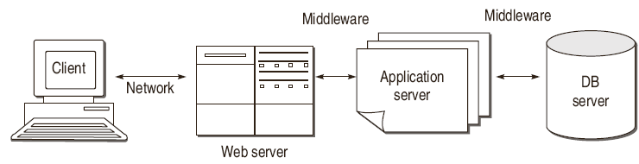
Evolution of Software Testing
Web Technology Evolution
Middleware are packages provided by software vendors to handle communications , data translation and process distribution.

Slide 3
Challenges in Testing for
Web-based Software
Diversity and Complexity
Dynamic Environment
client side programs and contents may be generated dynamically
Very short development time
Continuous evolution
Compatibility & Interoperability

Slide 4
Quality Aspects
Reliability
Performance
Security
Usability
Scalability
Availability
Maintainability

Slide 5
Navigation Testing
The links should not be broken due to any reasons.
The redirected links should be with proper messages displayed to the user.
Check that all possible navigation paths are active.
Check that all possible navigation paths are relevant.
Check the navigations for the Back and Forward buttons, whether these are properly working if allowed.

Slide 6
Security Testing
Security Test Plan
Securing testing can be planned into two categories:
Testing the security of the infrastructure hosting the Web application and testing for vulnerabilities of the web application.
Firewalls and port scans can be the solution for security of infrastructure. For vulnerabilities, user authentication, restricted and encrypted use of cookies, data communicated must be planned. Moreover, users should not be able to browse through the directories in the server.

Slide 7
Security Testing
Various Threat Types and their corresponding Test cases
Unauthorized User / Fake Identity / Password Cracking
Cross-site scripting (XSS):
Buffer overflows
URL Manipulation
SQL Injection : Hackers can put SQL statements through the web application user interface into some queries meant for querying the database . In this way he/she can get vital information from the server database.
Denial of Service

Slide 8
Performance Testing
Performance Parameters
Resource utilization
Throughput
Response time
Database load
Scalability
Round trip time

Slide 9
Performance Testing
Load testing
Many users, large I/P data from users, simultaneous connection to DB ,heavy load on some specific pages etc
Stress testing

